Slide 1
Million Song Dataset
Music Recommendation System
Mingjun Liu
Xindi Huang
Tian Yang

Slide 2
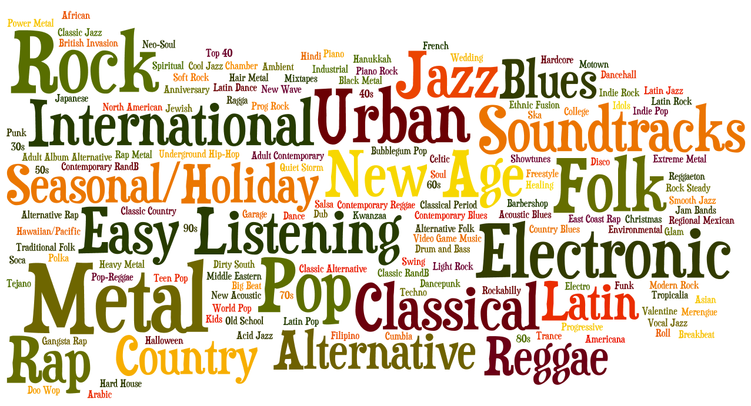
Introduction
Research Problem:
There are thousands of songs being published each day, and it’s hard to find what people might like among the large number of songs. We want to build a music recommendation system which can explore other users’ playing history to recommend music that are most likely to be liked by our users.

Slide 3


Motivation
Why Important?
People don’t have enough time or energy to create their own playlists
Maximize the power of the Long Tail
Help musicians and artists to find the audience that they deserve

Slide 4
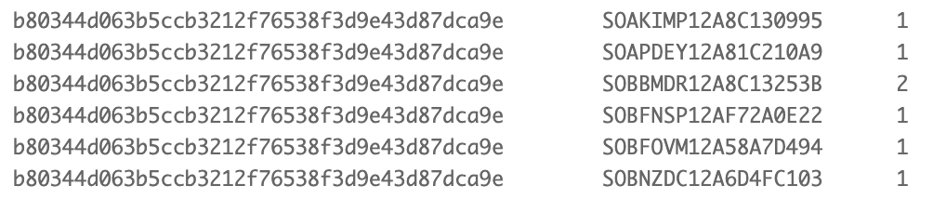
Our Data
(user, song, play count) triplets
Each taste profile has at least 10 unique MSD songs worth of activity
The largest music activity dataset made available to researchers

Slide 5


Dataset
Our Data set: Million Song Dataset
The entire dataset (~280 GB)
A subset of 10,000 songs (1%, 1.8 GB compressed) for this project
Taste Profile subset (~500MB) ----- focus on user listening data
1,019,318 unique users
384,546 unique MSD songs
48,373,586 user - song - play count triplets

Slide 6
Data Processing
Test Dataset
Raw Dataset
Cleaning
Analyzing
sorting
Input Dataset
Split into sets
Train Dataset
Split into
Apply to
Evaluation & Compare Results
Testing
Results
Different Models/method
Test (visible) Dataset
Test (invisible) Dataset

Slide 7
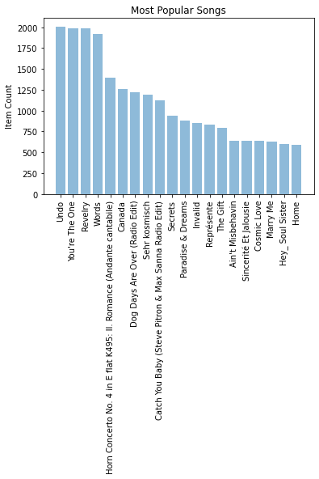
Methods
Popularity-based Method
The recommendation system will recommend the most popular songs to users.
K-Nearest Neighbors(KNN)
Collaborative Filtering
Matrix Factorization

Slide 8
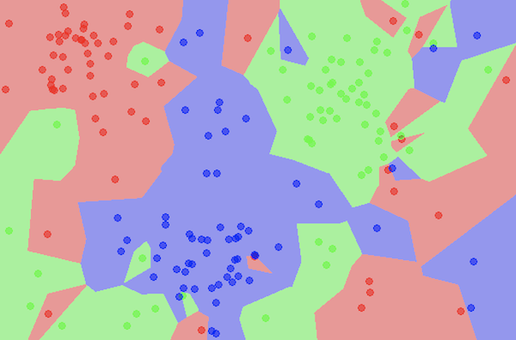
Methods
Popularity-based Method
K-Nearest Neighbors(KNN)
For each test user, we defined their play count for each song in dataset as their feature vectors. Then, calculate the cosine similarities between the test user and other users to find K closest neighbors.
Collaborative Filtering
Matrix Factorization

Slide 9
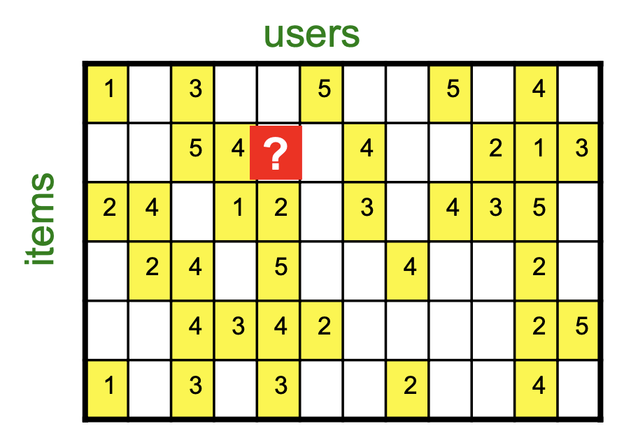
Methods
Popularity-based Method
K-Nearest Neighbors(KNN)
Collaborative Filtering
We explored similarities in rating behavior among users.
User-based / Item-based
Matrix Factorization

Slide 10
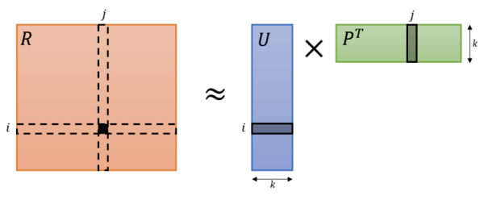
Methods
Popularity-based Method
K-Nearest Neighbors(KNN)
Collaborative Filtering
Matrix Factorization
We used Singular Value Decomposition (SVD) which was able to remove unrepresentative or insignificant users or items thus reduced the dimensionality of matrix.

Slide 11
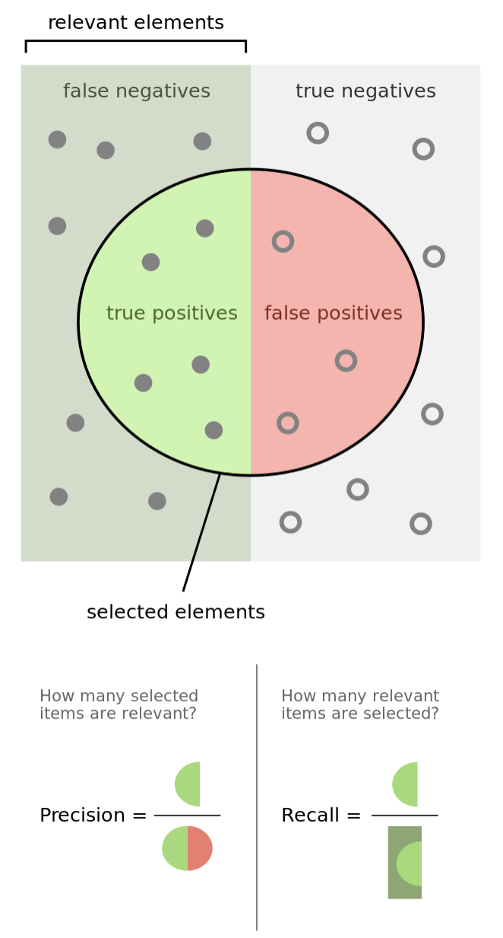

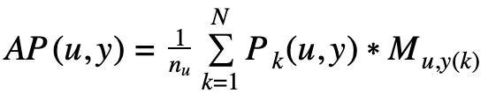

Evaluation
Metric: Mean Average Precision
Mean of the average precision scores for each user.
y(i)=s means song s is ranked at position pi
Find precision at each point k from 1 to N:
For each user, find average precision:
Get mean value over the users:
Include weightage of the ranks in calculation the precision

Slide 12
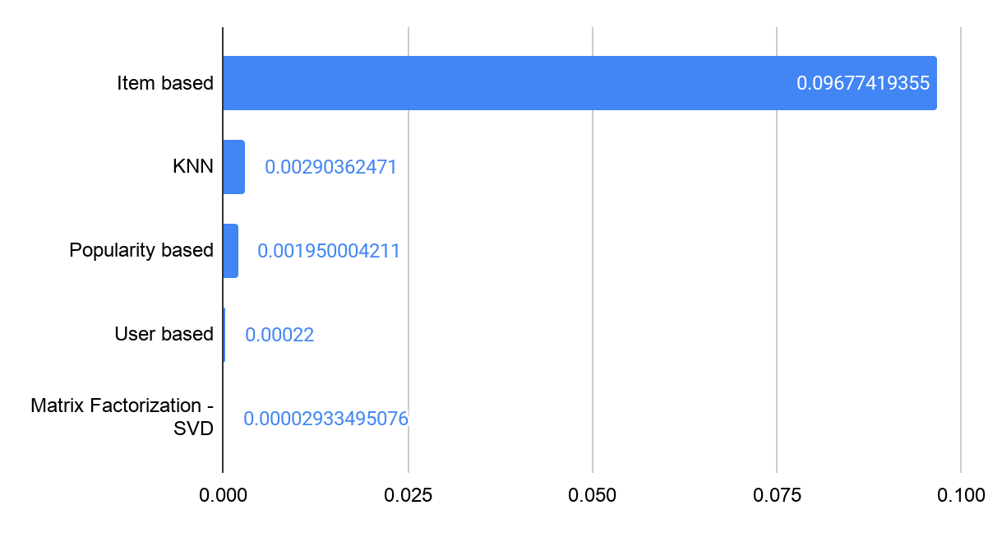
Evaluation
Results

Slide 13
Conclusion & Discussion
Choosing parameters for each methods.
Learn evaluation methods for recommendation system.
Cold start problem
This can be suggests by the popularity and matrix factorization methods.
Runtime of the training process limit the size of user sample.
Hard to find perfect matching similar user
Need to find out optimal solution for user-training process.
Future work:
Clustering features -- apply metadata

Slide 14
Thank you!

